Slide 1
Language Documentation and Standards in Digital Humanities:
TEI and the documentation of Mixtepec-Mixtec
PhD Thesis: École Pratique des Hauts Études (Inria - ALMaNaCH)
Jack Bowers
Austrian Center for Digital Humanities (ACDH)

Slide 2
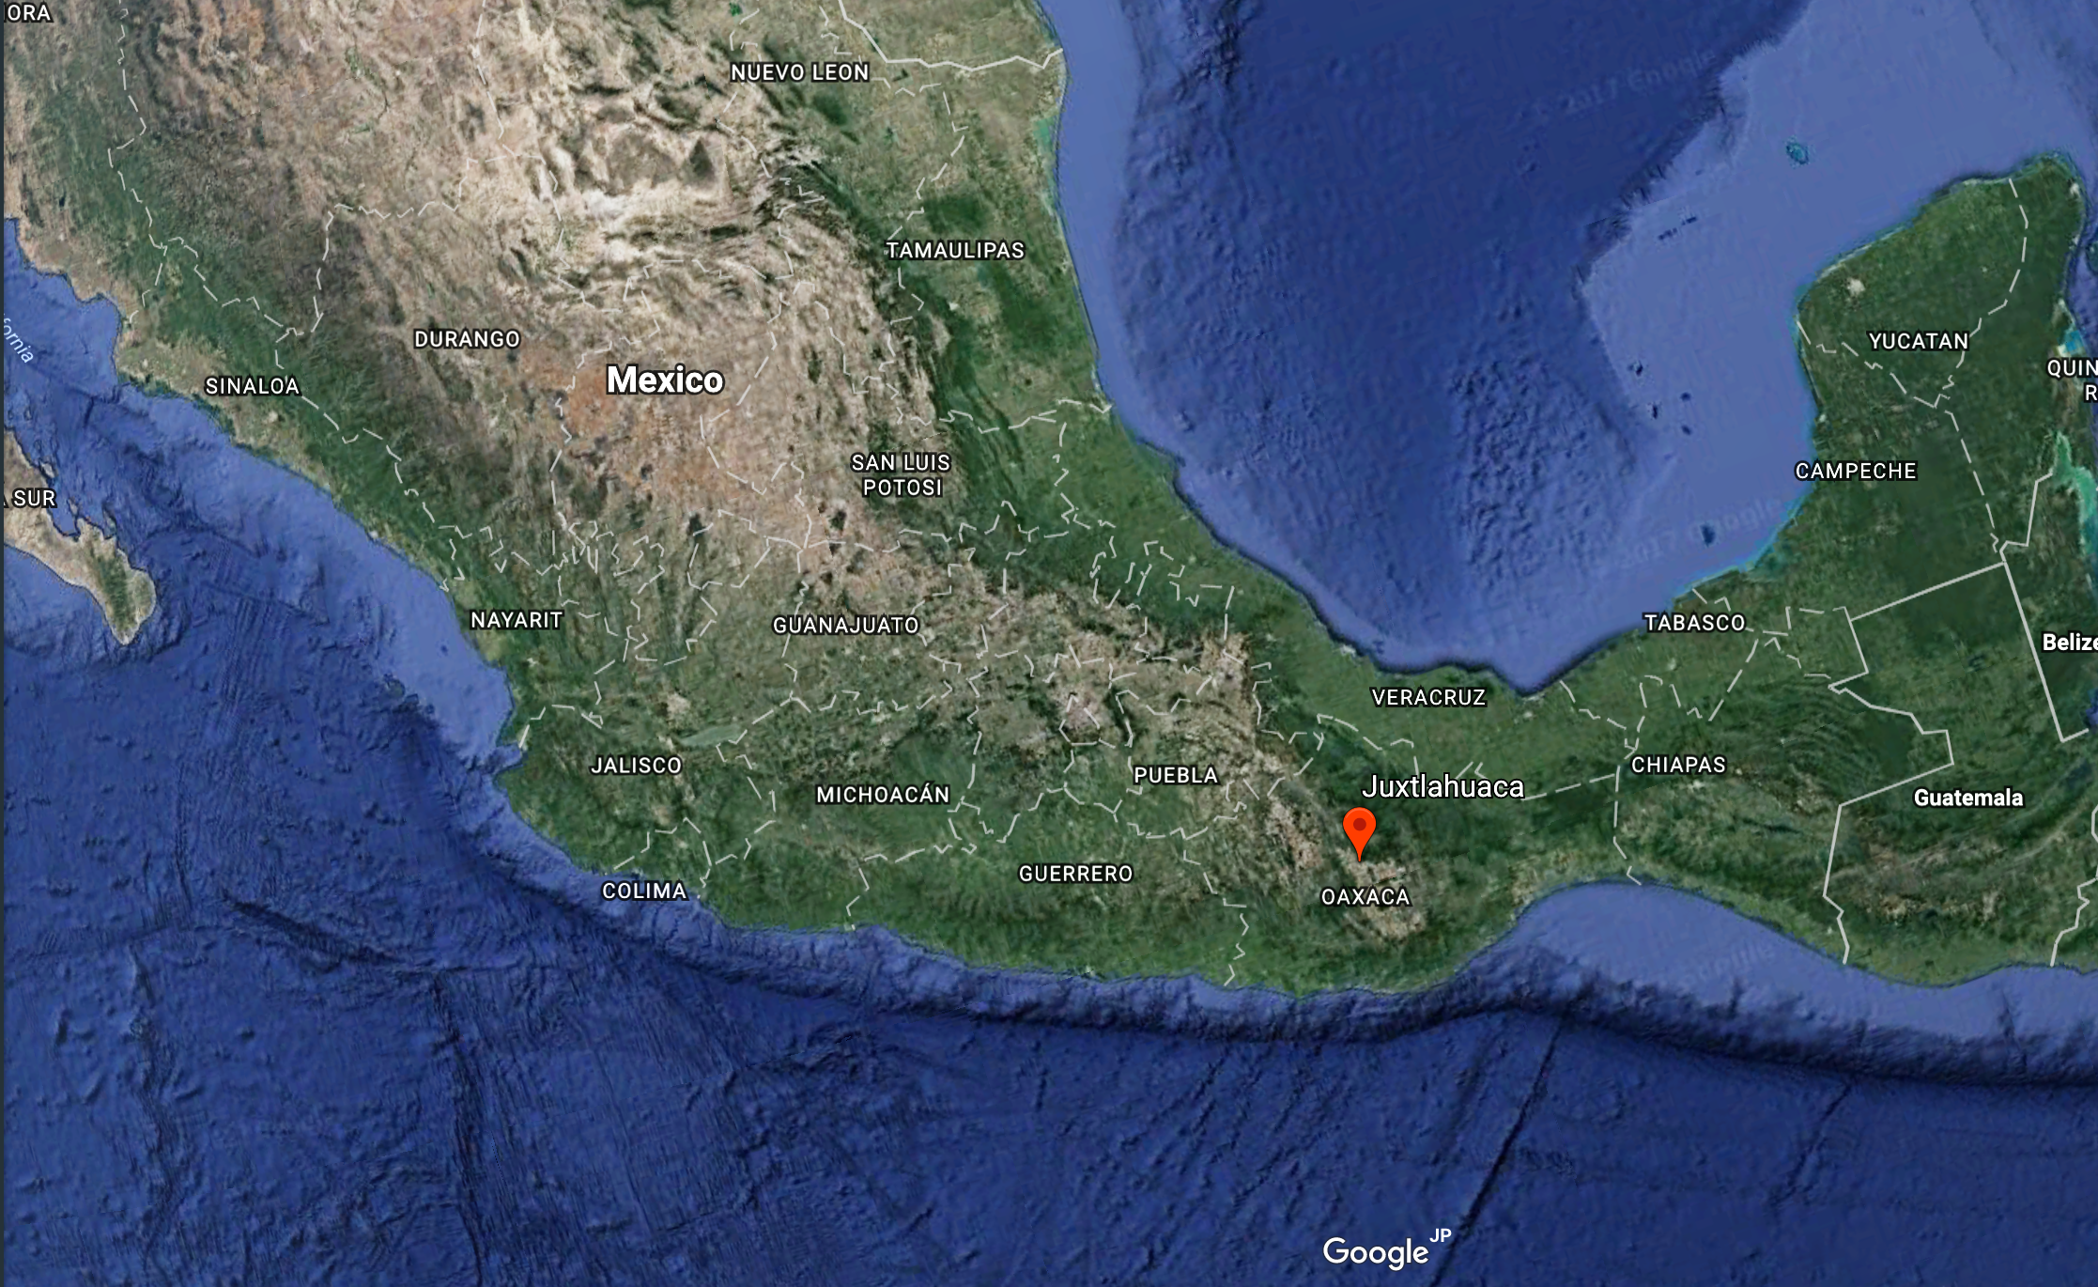
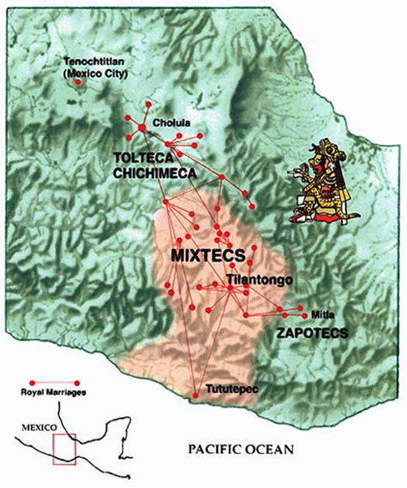
Mixtepec-Mixtec (Sa'an Savi)
Sa’an Savi ‘rain language’
ISO 639-3 code: ‘mix’
Oto-Manguean, Mixtecan, Mixtec-Cuicatec, Mixtepec-Mixtec
San Juan Mixtepec (SJM) in Juxtlahuaca district (Oaxaca, MEX)
Main speakers from village called Yucunani in SJM municipality
Not endangered
Estimated (+-7,600 speakers)
Source: INEGI (2010)

Slide 3
Desired Outcomes
Create an open source body of multimedia LR marked up in TEI
Further the knowledge of the language
Demonstrate and evaluate the application of standards to under-resourced language
Produce and publish empirical corpus-based descriptions and analyses of MIX linguistics
Apply cognitive linguistics theoretical concepts to corpus annotation

Slide 4
Specific TEI Output
TEI dictionary
Time aligned annotated utterance files
Annotated TEI versions of booklets published by Summer Institute of Linguistics (SIL) Mexico
Lexical feature inventory
Concepts inventory
Place inventory
Person list

Slide 5
Basic Challenges in Studying Mixtepec-Mixtec
Lack of resources & linguistic description
Speaker consultants limited availability
Lexical tone, adds complexity, not represented in the orthography
Orthography changing (SIL Mexico), sources contain variants, speakers don’t use it

Slide 6
Primary Sources of Mixtepec-Mixtec Language Data
Consultation w/ Speakers (Recordings)
Written content from speakers
SIL Children’s Booklets
Public Sources (YouTube, etc.)
Small number of academic papers
Personal communications

Slide 7
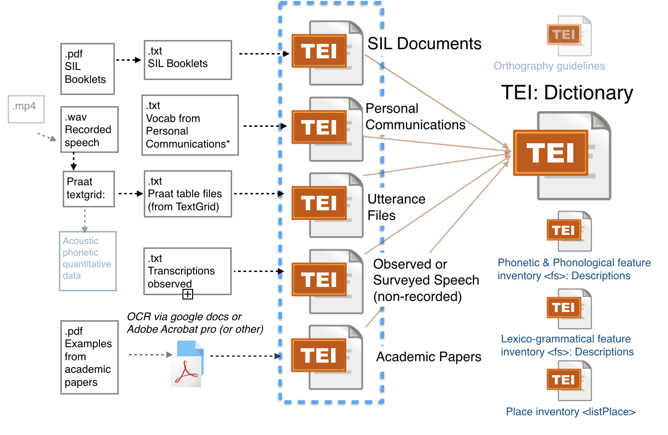
Mixtec Data: Sources, Links, Output

Slide 8
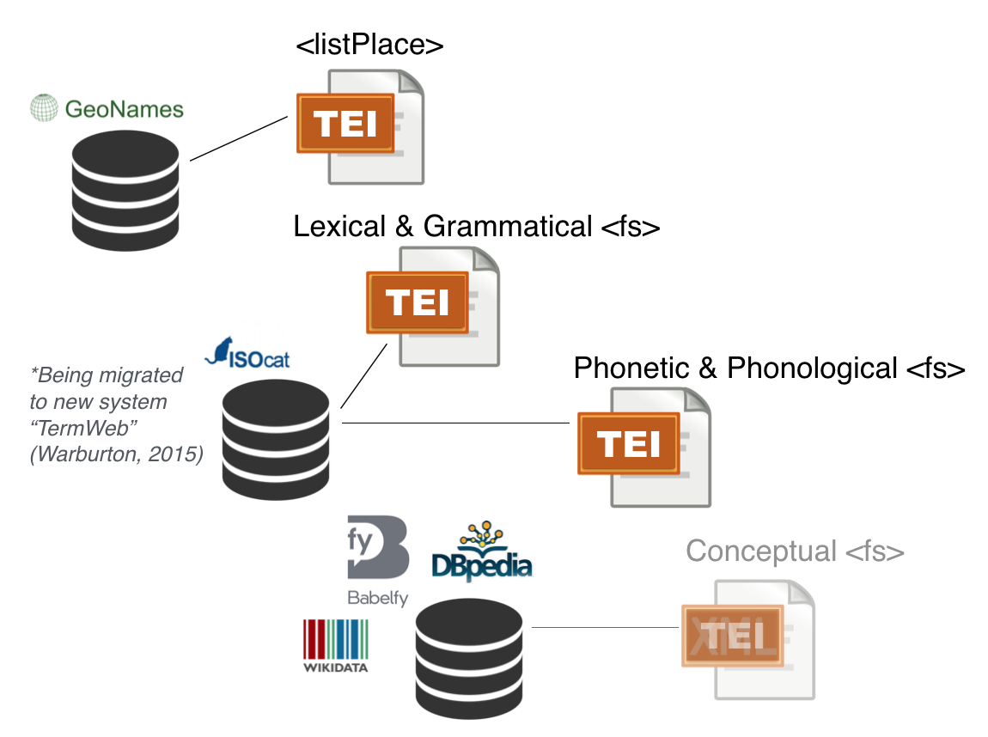
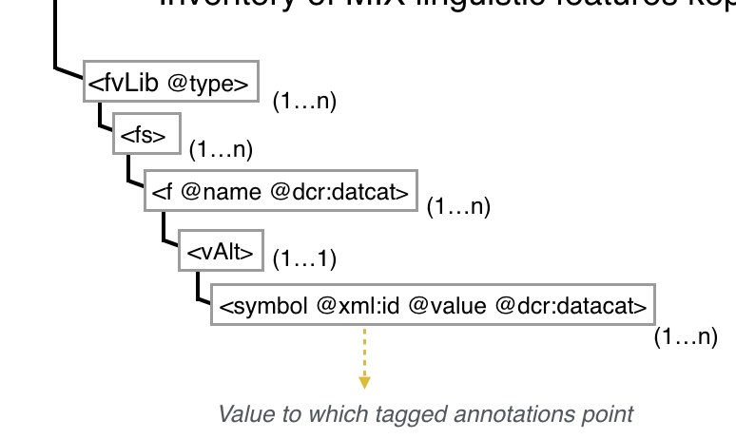
TEI Feature Structures & Standardized Resources
<fvLib>
<fs>
<f name="number" xmlns:dcr="http://www.isocat.org/ns/dcr" dcr:datcat="http://www.isocat.org/datcat/DC-3351">
<vAlt>
<symbol xml:id="SG" value="singular" dcr:datcat="http://www.isocat.org/datcat/DC-252"/>
<symbol xml:id="PL" value="plural" dcr:datcat="http://www.isocat.org/datcat/DC-253"/>
</vAlt>
</f>
</fs>
<!-- other feature structures here -->
</fvLib>

Slide 9
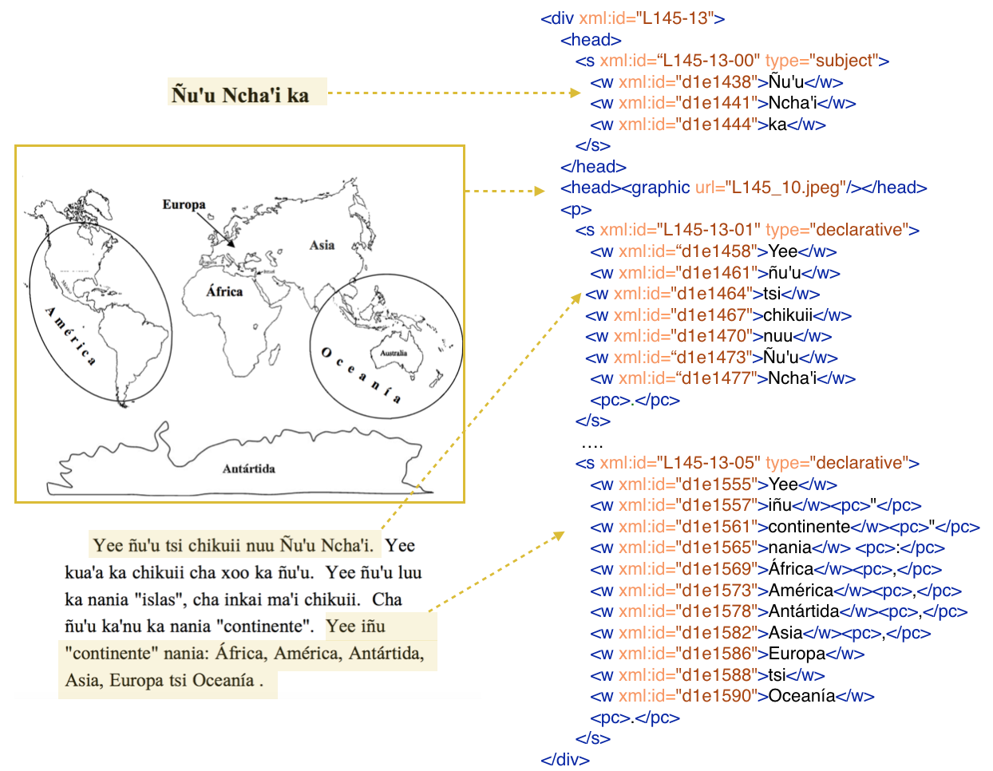
SIL Documents: Prose
Source Document
TEI Encoding

Slide 10
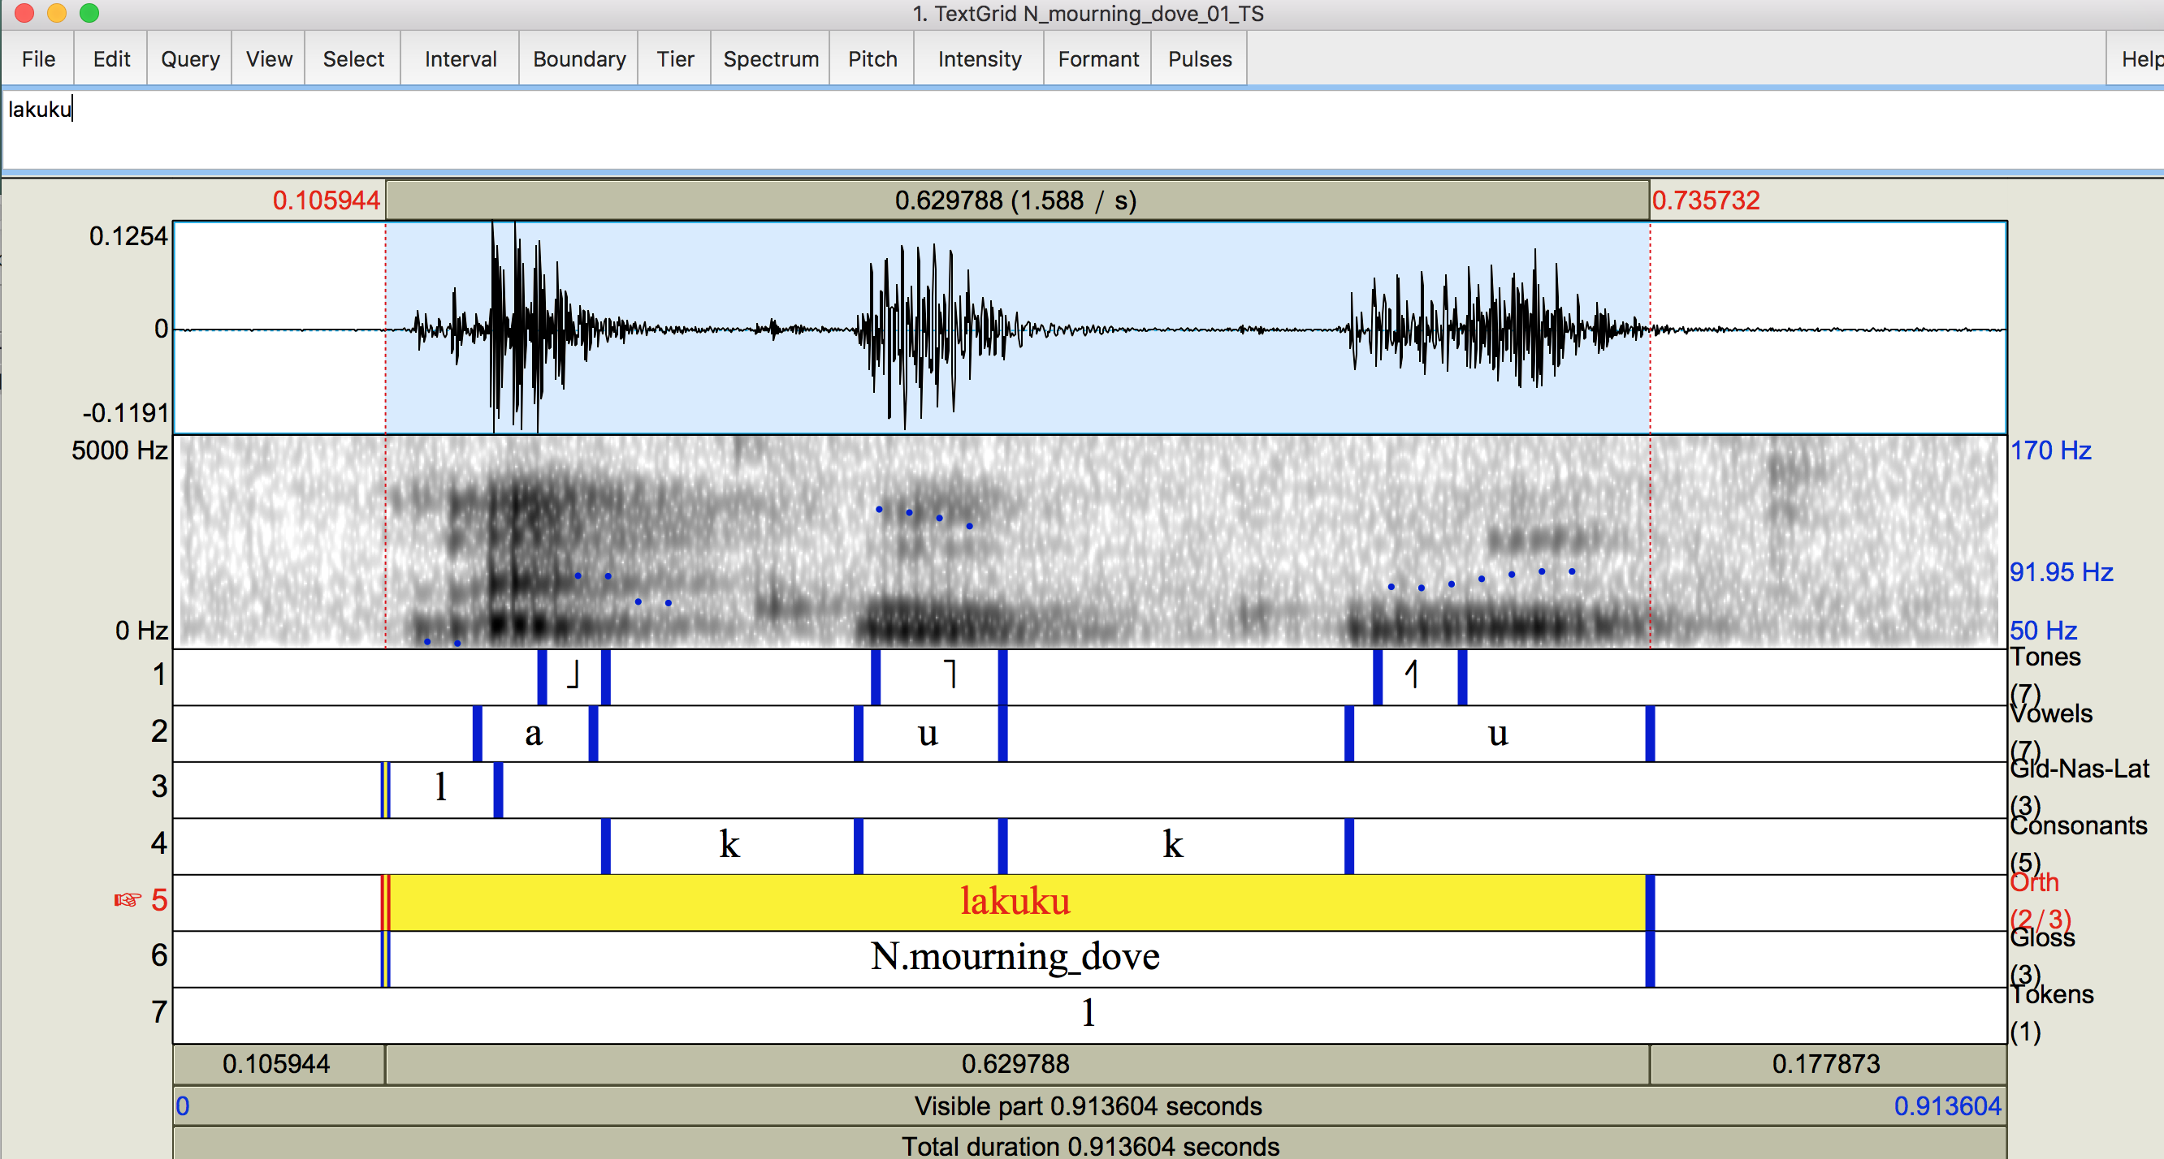


Speech Annotation: Praat (phonetic focus transcription)
tmin tier text tmax
0 Tokens 1 0.91
0.11 Gld-Nas-Lat l 0.16
0.11 Orth lakuku 0.74
0.11 Gloss N.mourning_dove 0.74
0.15 Vowels a 0.21
0.18 Tones ˩ 0.22
0.22 Consonants k 0.34
0.34 Vowels u 0.41
0.35 Tones ˥ 0.41
0.41 Consonants k 0.59
0.59 Vowels u 0.74
0.60 Tones ˧˥ 0.64
Utterance File <u>
TEI

Slide 11
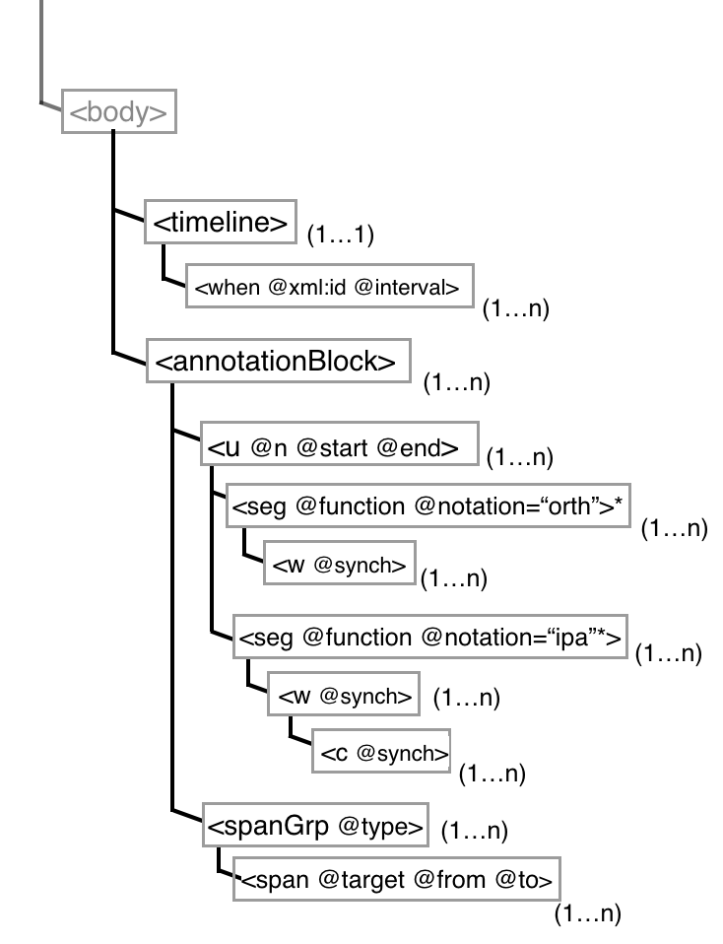
TEI Utterance files (from Praat)
(abbreviated model)
<timeline>
<when xml:id="T1" interval="0.11"/>
<when xml:id="T2" interval="0.15"/>
<when xml:id="T3" interval="0.18"/>
<when xml:id="T4" interval="0.22"/>
<when xml:id="T5" interval="0.34"/>
<when xml:id="T6" interval="0.35"/>
<when xml:id="T7" interval="0.41"/>
<when xml:id="T8" interval="0.59"/>
<when xml:id="T9" interval="0.60"/>
<when xml:id="T10" interval="0.74"/>
</timeline>
<annotationBlock> <u xml:id="d1e39" n="1" start="0" end="0.91"> <seg xml:id="d1e40" function="utterance" notation="orth"> <w xml:id="d1e41" synch="#T1">lakuku</w> </seg> <seg xml:id="d1e44" function="utterance" notation="ipa"> <w xml:id="d1e45" synch="#T1"> <c>l</c> <c>a</c> <c function="tone">˩</c> <c>k</c> <c>u</c> <c function="tone">˥</c> <c>k</c> <c>u</c> <c function="tone">˧˥</c> </w> </seg> </u> <spanGrp type="translation"> <span xml:lang=“en”target=“#d1e41 #d1345”>mourning dove</span> </spanGrp>
…..
</annotationBlock>
(partial view)

Slide 12
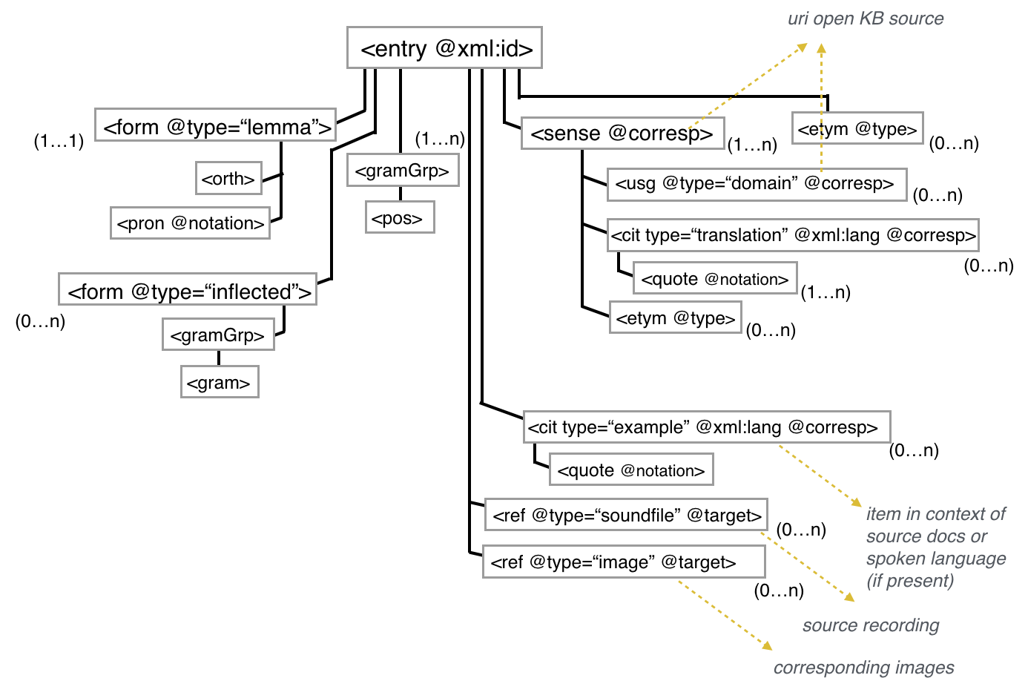
TEI Dictionary Entry: Abstract Model

Slide 13
TEI Dictionary Entry: Abstract Model

Slide 14
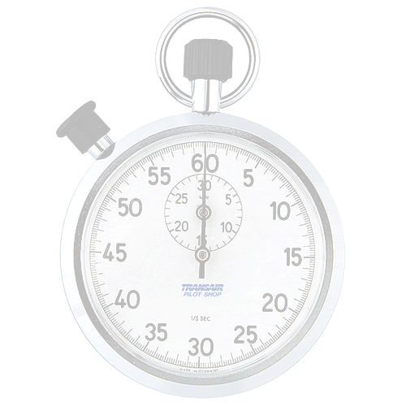
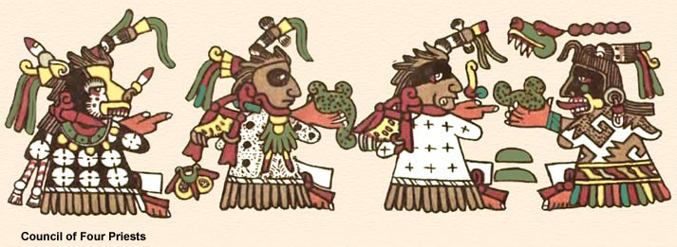
Time’s Up!
Jack Bowers
iljackb@gmail.com
(ÖAW) Austrian Center for Digital Humanities
B.A. History & French San Francisco State
M.A. Linguistics San José State University
Inria: 2014-2015
ÖAW (ACDH) 2015-present
PhD ÉPHE (ALMAnaCH - Inria) 2016-present
Mixtec Codex Nuttal- British Museum

